Slide 1
Practice 9

Slide 2
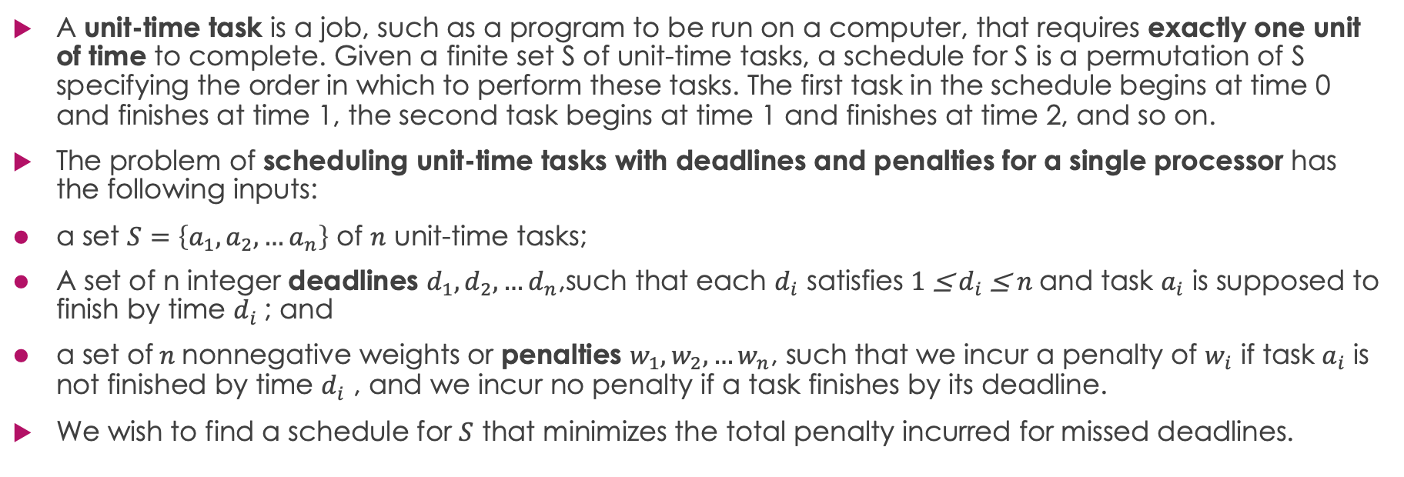
A Task-scheduling Problem
A unit-time task is a job, such as a program to be run on a computer, that requires exactly one unit of time to complete. Given a finite set S of unit-time tasks, a schedule for S is a permutation of S specifying the order in which to perform these tasks. The first task in the schedule begins at time 0 and finishes at time 1, the second task begins at time 1 and finishes at time 2, and so on.
The problem of scheduling unit-time tasks with deadlines and penalties for a single processor has the following inputs:
a set $S=\left\{a_{1}, a_{2},…a_{n}\right\}$ of $n$ unit-time tasks;
A set of n integer deadlines $d_{1}, d_{2},…d_{n}$,such that each $d_{i}$ satisfies $1$≤ $d_{i}$ ≤ $n$and task $a_{i}$ is supposed to finish by time $d_{i}$ ; and
a set of $n$ nonnegative weights or penalties $w_{1}, w_{2},…w_{n}$, such that we incur a penalty of $w_{i}$ if task $a_{i}$ is not finished by time $d_{i}$ , and we incur no penalty if a task finishes by its deadline.
We wish to find a schedule for $S$ that minimizes the total penalty incurred for missed deadlines.

Slide 3
Sample Input:
Sample output:
Time slot: 0 1 2 3 4 5 6 7
3 | 2 | 4 | 1 | 7 | 6 | 5
The answer is not unique. There are many other possible solutions.
For example:
Time slot: 0 1 2 3 4 5 6 7
1 | 2 | 4 | 3 | 7 | 5 | 6

Slide 4
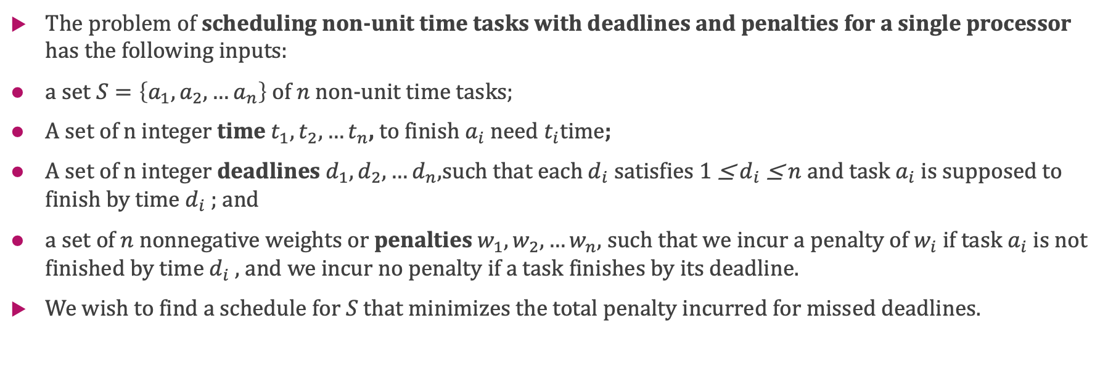
Another Task-scheduling Problem
The problem of scheduling non-unit time tasks with deadlines and penalties for a single processor has the following inputs:
a set $S=\left\{a_{1}, a_{2},…a_{n}\right\}$ of $n$ non-unit time tasks;
A set of n integer time $t_{1},t_{2},…t_{n}$, to finish $a_{i}$ need $t_{i}$time;
A set of n integer deadlines $d_{1}, d_{2},…d_{n}$,such that each $d_{i}$ satisfies $1$≤ $d_{i}$ ≤ $n$and task $a_{i}$ is supposed to finish by time $d_{i}$ ; and
a set of $n$ nonnegative weights or penalties $w_{1}, w_{2},…w_{n}$, such that we incur a penalty of $w_{i}$ if task $a_{i}$ is not finished by time $d_{i}$ , and we incur no penalty if a task finishes by its deadline.
We wish to find a schedule for $S$ that minimizes the total penalty incurred for missed deadlines.

Slide 5
Please implement the 2 questions.
The practice will be checked in this lab class or the next lab class(before May.31) by teachers or SAs.
This practice will contribute 1 mark to your overall grade. Late submissions within 1 weeks after the deadline (before June.7)will incur a 20% penalty, meaning that you can only get 80% of the score.

